Slide 1
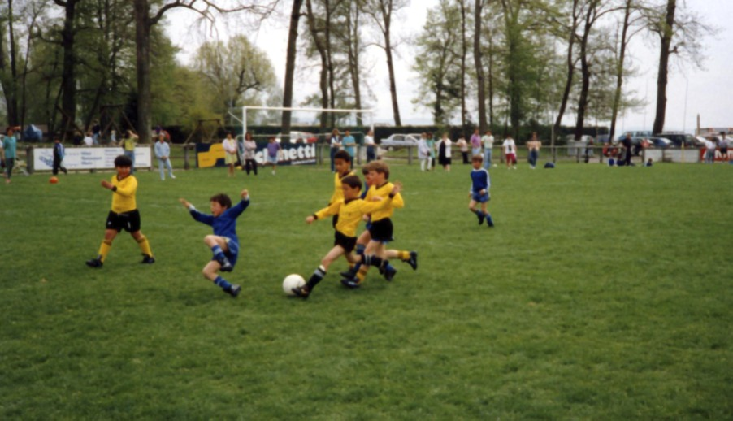
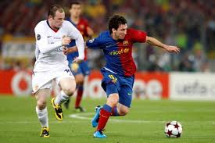
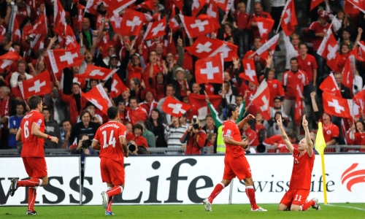
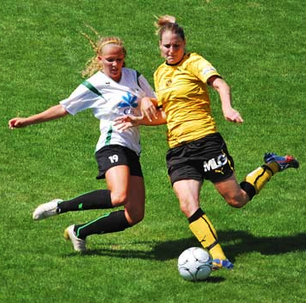
Exciting Football
Notes:
Before beginning this presentation, we would like to know how many of you are already involved in football?
As chiropractors? Players? Trainers? Referees? Officials? Parents? You follow the games in the medias? Something else?
So out of 22 you are 11(?) already involved in football.

Slide 2
Thanks
Sonia Testaguzza (Department Manager Women & Girls Football at SFA)
Yves Débonnaire (Manager of Trainer Education at SFA)
Bernard Challandes (Elite Football Trainer – U21, Zurich, Thoune, etc)
Pierre Cornu (former UEFA chief legal council for integrity and regulatory affairs, former Swiss public general prosecutor, Senior Legal Counsel at the CIES)
And… Markus Frei (Chief of Carreer Planning at SFA)
Notes:
Thanks to Sonia (time and videos)
Thanks to Yves (time, vidéos, pptx)
Bernard (quite the second presenter, lot of time dedicated to elite football)
Pierre Time to financial fair-play, betting, criminality, how associations funtion on legal/regulation point of view)
Markus for being here

Slide 3
What is football?
A sound sport
A fascinating game
A fantastic social impact
  All tournament long the teammates poignantly reminded the world they were playing for their battered country, still reeling from the devastation of the March 11 earthquake and tsunami.
A wonderfull educational tool
Notes:
Is it just a game dedicated to gentlemen where 22 brutes fight for a single ball? No of course!
It is a sound sport contributing to the health of all players
It is a fascinating game providing pleasure, passion and fun at each level of football
It is a fantastic social impact, remember 2011, 4 months after the tsunami the japanese women team won the world championship in Germany. VIDEO. At the end of the final game the players told every media that their main motivation was to demonstrate that Japan could be successfull even under hard circumstances.
It is a wonderfull educational tool developping values, readyness to learn, self-confidence, willingness, team spirit, winning attitudes, etc…
So you understand that we will talk about our passion while having a secret objective: at the end of our presentation (may be even before) you will agree that football is wonderfull

Slide 4
Our 3-parts agenda
Organization of football
Short break
Skills, competencies, capabilities, knowledge
Short break
Top football experiences, career planning, coaching
Notes:
Organization of football: let’s talk about the FIFA and other associations, the rules, the competitions, finance and merchandising, the materials, the grounds, transports etc..
First of all, notice that we will not differentiate boys and girls because in most cases we consider both. This is valid for kids, teenagers, young adult and seniors. We will also talk about base football, how young talents are managed in Switzerland and professional football.
Actors of football: Who would you mention as actors or contributors to football: clubs and teams, players, referees, trainers, team staff, parents, fans, spectators, hooligans, stadium staff, medias, authorities as well as … you chiropracters
Skills, competencies, capabilities, knowledge: here you will get information and examples about Co, Te, Ta, mental skills etc. we will dedicate some time to trainer education including methodology, objective planning, and why practising and understanding practice is crucial
Top football (nations, clubs, players): Markus will developp several chapters of top football activities for a trainer: act as a manager (inside and outside –media), how to get 120% of each player, know the opponent as well as your own team, manage injured players, the limits between medical care and doping. How to cope with simulations…etc.
What about science in football: biology (energy sources, food and drinking, recovery), biomechanics (optimize speed, running, strength, explosive strength), neurosciences, psychology, cognitive development, statistics (game statistics, behavioral statistics, GPS) etc…

Slide 5
Organization in football
Competitions
  National teams
  Clubs
  Categories
Rules
  The 17 Laws of the game
Actors in football
  On the pitch
  Around the pitch
  Outside (Media, materials providers)
Finance
  Event income and costs (ticketing, primes, TV rights, players)
  Merchandising and derived products,
  Sponsoring, betting, criminality
Notes:
First part

Slide 6

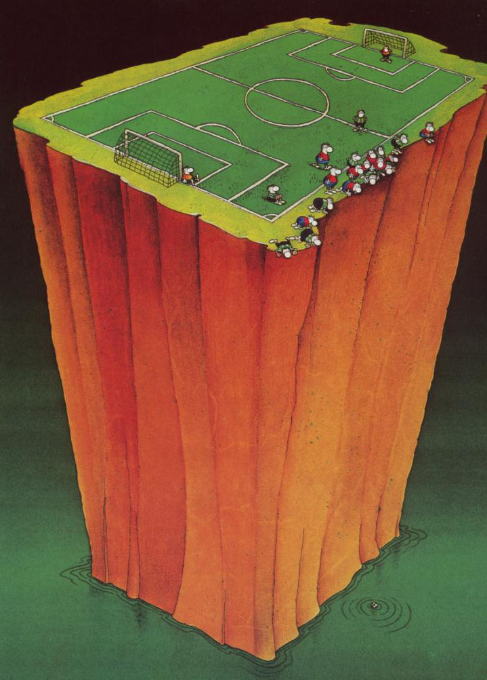















Who is organizing football?
Notes:
First of all, you can see here an example of what organization could be in football…International Federation of Association Football, but the french acronym stays valid. Motto: For the Game. For the World. Role: The laws that govern football, FIFA frequently takes active roles in the running of the sport and developing the game around the world. One of its sanctions is to suspend teams and associated members from international competition when a government interferes in the running of FIFA's associate member organisations or if the associate is not functioning properly.
UEFA has more or less the same role but in Europe.
SFA is member of UEFA and FIFA and deals with all aspects off football in CH
Associations have their own regulations to govern all aspects of football. Also they don’t like if clubs go to civil juridictions, and they have point which foresees sanctions for clubs which do so. We had the case with Sion in Switzerland. At the end, Sion lost on all aspects!
Fans club Juventus: 180 M worldwide, 43 M in Europe, 12M in Italy!
FUTSAL VIDEO.
J+S: 60 MCHF for 75 sports
Swiss Olympics: financial support for talents and in antidoping
CIES last demographic study and study about young players used in the Swiss championship

Slide 7
Competitions
Worldwide and Continental
  World championship, JO, CAN, Copa America, EURO, U21, U17
  Champions League, Europa Cup, Copa Libertadores
National
  Championship, Cup,
  Regional teams
  Sponsors Cup
Regional
Lower levels
Juniors and kids
Combined levels
Corporative football
All informal competitions
Notes:
VIDEO DVD Champions League Women 2011

Slide 8
The Laws of Game (17)
We need rules to play football
  The ground (dimensions, goals, surface, lines, environment)
  The teams (players,age,licence, number, etc)
  The referees (number, qualification, age)
  The ball (weight, material, pressure, size)
  The equipment (dress, short, shoes, gloves, others)
  The game (time, goals, faults, hands, offside, out, errors)
  Postponing, starting or interrupting a game (numbers, weather, etc)
  Environment (stadium, audience, media)
Notes:
Show equipment at point 5
Ask for hands penalty
Ask for off-side
Show video But compliqué

Slide 9
Actors of football
Clubs and teams
Players
Trainers
Referees
Team staff (you!)
Audience (fans, spectators, parents, hooligans, stadiers)
Medias
Managers
Other (authorities)
Notes:
Show video Karpov for a sympathic trainer

Slide 10
Finance: Match day
Ticketing
Players (salaries, primes, transfers)
TV rights
Notes:
Arsenal in his new stadium increased the ticketing from 37 to 94 M£, the stadium welcomes 60355 spectators . Our club FC Helvetia we have no ticketing revenue end the total budget is 15’000 CHF per year…
Arsenal 416 employees, 66 players and more than 30 staff employees Djourou 50’000£ per week… ou 3,5MF per year, Total 120MEuro
Arsenal 15’000£ for primes for a won game, Barça 4M€ for the triple title in 2009
Arsenal budget 380M£
Average salary per year / per month for players of:
1 -Chelsea 4.252.109 € 344.321 € / mois
2 – Manchester City 4.130.008 € 335.334 € / mois
3 – Manchester United 3.504.246 € 292.020 € / mois
4 – Liverpool 3.387.328 € 282.277 € / mois
5 – Arsenal 3.265.450 € 272.121 € / mois
Transfers of top players are very expensive. In 1982 Maradona to Barcelona for 8M. Barcelona organised a huge reception with fans and many shirts to sell. After this event the transfer was already financed! Before he has played any minute for his new team!
TV rights: Spain 2014 800ME, Premier League 3B£ for 3 years

Slide 11
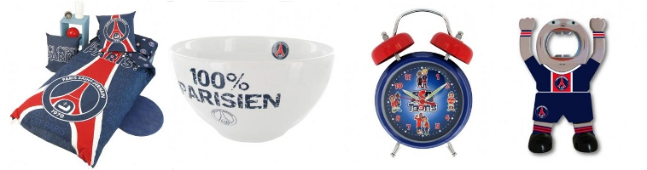
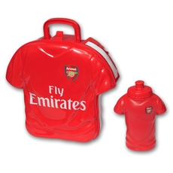
Finance: Merchandising
Merchandising
  In 2009/2010 Real Madrid sold 1’200’000 shirts of Cristiano Ronaldo at 85 Euro each: Year income: 102’000’000 Euros
  Derived products:
  You can even buy sextoys…
Notes:
Les ventes de maillots ne cessent elle aussi de se développer ainsi lors de la saison 2009-2010 le club Madrilène a vendu près de 1.200.000 maillots de Cristiano Ronaldo à 85€ l'unité ce qui constitue une ressource d'environ 102.000.000€.

Slide 12
Finance: Sponsoring, betting, criminality
Sponsoring
  Equipment, ad on shirts, name of the stadium
  Private sponsorship
Betting
  About what, when and how?
  Quotes
  Margins
  Illegal betting
  Betting fraud
Notes:
Emirates stadium name is a 15 years deal for 100M£, recently 150M£ for 5 years on the shirts till 2018/2019

Slide 13
Finance: Financial Fair-Play
Situations of various clubs
  Debts
  Value of the club
The Financial Fair-Play
  Why
  Balanced budget
  One private sponsorship
Notes:
Even the high value of ManU 1700 M£ the debts are 590M£ and the interest is 107M£
In Spain the first division has debts of 1BEuro to the state (social charges) and total debts are 4BEuros
There are 23 clubs in Europe which are in a status of default of payment, 22 are from Spain
In Germany tax authorities prohibit clubs to have costs higher than revenues, and do not allow debts
In Switzerland the SFA adapted his rules, after the fiasco of Neuchâtel Xamax
Why FFP? The main reasons where just discussed and the objective is to ensure the same chances to all clubs (from a financial point of view) and having an independency/autonomy of those clubs
First criteria for FFP: no overdue debts to clubs, players and state
Over three years demonstrate financial balance, without including infrastructures and education
The whole process will include some plus minus margins.
There will be a maximum of percentage of sponsoring by a single source (private or not) to prevent the death of a club if this sponsor stops his contribution
In such a case UEFA will check if the amounts can be related to an economic activity (100 MEuros for PSG from Qatar, compensation PSG should help Qatar)
Same case with Chelsea, Abramovitch already spent 800M£…
Lets start the system and have a look on how UEFA deals with such cases
End of first part

Slide 14


Slide 15
Skills, Competencies, Players development and training
SFA Philosophy
The trainer
Skills of players
  Physical condition
  Technics (coordinative capabilities)
  Tactics (field occupancy, behavior)
  Mental (cognitive aspects, emotions)
Notes:
How to manage the energy needed for the competitions, recovery, flexibility of articulations and muscles, running technics, strength, explosive strength, stretching dynamic work on movements amplitude, pliometry, injuries, food and beverages, medical treatment, doping, etc.
Every thing you need to do something with the ball, Coordinative capabilities
What is tactics and what is behaviour? Zone, offensive, defensive, transitions, individual, blocks, teams, special situations
Readyness to learn, willingness, cognitive capabilities, the catalog (synapsic connexions), anticipation, body language, simulations

Slide 16
We play with dynamism
We play offensively
We play in zones
And with the willingness of giving the best we can and all we can to impose our manner of playing
By using adapted technics, attacking and aiming to score at each opportunity
In an ambitious and agressive manner, our teams are well organised, stay compact and push our opponents to fail
SFA Philosophy of our football
Notes:
Philosophy defines the quality of play. She provides us criteria to observe and anlyse the games at all levels
Philosophy focuses thoughts and actions of players and trainers toward a common objective. Our strengths and energies are combined to enables the development of a culture of football.
Philosophy is the starting point as well as the ultimate objective of education. We must train as we want to play et we want to play as we train

Slide 17
SFA Philosophy - Collective Education
  Organisation of the team in 4-4-2 / 4-3-3 / 3-4-3
  Development of play
  Go forward in a clever manner
  Seek conclusion through the sides or the axes of the pitch
  Agressive zone marking and «defending chains»
  Transition when loosing the ball
    To defense and tackle your opponent
  Transition when getting the ball
    To attack, elaborate the game and seek actions forward

Slide 18
SFA Philosophy - Individual Education
  Basic technics and technics under pressure
    Pass and take the ball, conduct the ball and dribbling, shoot, technics in the air, header
  Behaviour in dual and covering (support)
    3 : 3 – 2 : 2 – 1 : 1 – 5 : 5
    Numeric superiority or inferiority
  Passion for football et ambition
    Initiative and intensity
    Positive, willingness, take responsibility
  Athletic education
    Harmonious and progressive development

Slide 19
SFA Philosophy - Training Methods
A close to game education is required
  Played forms constitute the main part of our training sessions
  Objectives are adapted to the players
  We have a relation Game – Analytical
  GAG method: Global (game) – Analytical (exercise) – Global (game)
  Variation and variability
  We work with goals (targets)
  Exercises and games on delimitated fields
  Teams and groups clearly identified
  Organisation of training sessions
Notes:
VIDEO TE

Slide 20
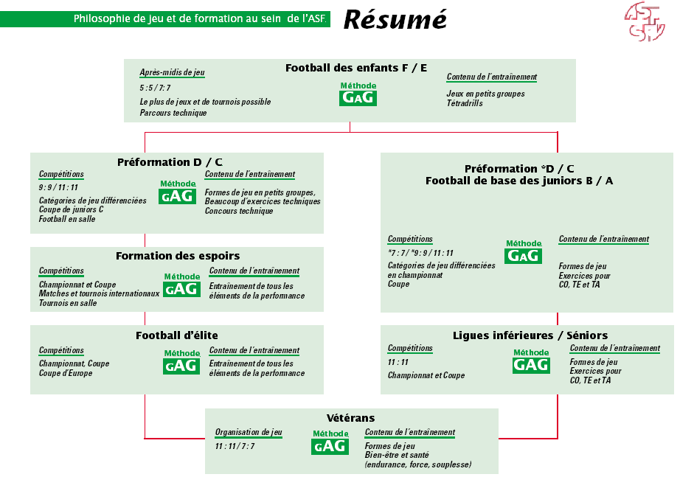

Slide 21
Skills, Competencies, Trainer education
  Content of trainer education
  What we expect from a trainer
  From kids trainer to professional trainer
  Philosophy of trainer education
Notes:
VIDEO FOOT à 7.
Basically a trainer must be able to demonstrate in practice what he requires the players to do. He must be able to explain in different manners what he wants from his team. He must be a good observer as well as have a perfect comprehension of what he wants from the players or the team. This important to detect wrong executions and correct them.
Very often the kids trainer is a single guy who should manage everything, the professional trainer works with a staff whome he assumes the ultimate responsibility, meaning he is accountable so he will be fired!
Educate, pass the diplomas, train and practice and go to the next step. As with the training of players, work according the methodology (easy to difficult, simple to complex, be successfull before progressing further, work analytically and globaly, in such a way theat the final form is always the real game)
Knowledge of the basics of your level (category), however specialists (like medical doctors) will support the courses at each level.
Some tools will also be provided depending on the level (communication, psychology, interpersonal skills (with all actors)

Slide 22
Structure of football education of trainers in 2012
Notes:
Between the different levels, at least one year practice
Some levels need to be successful on a pre-examination before attending the course
To go to the next course a participant must be succesful in the final examination of the attended level
At each level there is at least one lecture provided by a medical specialist to educate trainers on the physiology and personality of the players they should train

Slide 23
What we expect from a trainer for basic football
  He knows the football at the level where he is active
  He is able to demonstrate what he want the players to do and he is able to explain it in simple words
  He understands the right way of doing something and by
  Observing he is able to detect wrong execution and to provide the right correction
  He find the best way in communication with all involved persons
  He is seeking for excellence at each level
Notes:
VIDEO René Borkovic
Basically a trainer must be able to demonstrate in practice what he requires the players to do. He must be able to explain in different manners what he wants from his team. He must be a good observer as well as have a perfect comprehension of what he wants from the players or the team. This important to detect wrong executions and correct them.
Very often the kids trainer is a single guy who should manage everything, the professional trainer works with a staff whome he assumes the ultimate responsibility, meaning he is accountable so he will be fired!
Educate, pass the diplomas, train and practice and go to the next step. As with the training of players, work according the methodology (easy to difficult, simple to complex, be successfull before progressing further, work analytically and globaly, in such a way theat the final form is always the real game)
Knowledge of the basics of your level (category), however specialists (like medical doctors) will support the courses at each level.
Some tools will also be provided depending on the level (communication, psychology, interpersonal skills (with all actors)

Slide 24
What we expect from a trainer for elite football
  The previous slide is still applicable
  He is a professional, an expert on his job
  He has to communicate with much more interlocutors
  He deals with professional players with salaries…
  He is an accountable manager
The trainer is just a guru
Notes:
Basically a trainer must be able to demonstrate in practice what he requires the players to do. He must be able to explain in different manners what he wants from his team. He must be a good observer as well as have a perfect comprehension of what he wants from the players or the team. This important to detect wrong executions and correct them.
Very often the kids trainer is a single guy who should manage everything, the professional trainer works with a staff whome he assumes the ultimate responsibility, meaning he is accountable so he will be fired!
Educate, pass the diplomas, train and practice and go to the next step. As with the training of players, work according the methodology (easy to difficult, simple to complex, be successfull before progressing further, work analytically and globaly, in such a way theat the final form is always the real game)
Knowledge of the basics of your level (category), however specialists (like medical doctors) will support the courses at each level.
Some tools will also be provided depending on the level (communication, psychology, interpersonal skills (with all actors)

Slide 25
Where to start with training?
·
·
Notes:
Lets come to the content of training
What can you see on this slide?

Slide 26
Give the ball to one player…
2:2
·
·
1:1
4:4
2:1
4:2
Notes:
1:1 offensive
The striker must be able to fake or dribble the center back and to make a goal by shooting or dribbling the goal-keeper
Which skills does he need to accomplish this?
How can you fake or dribble an opponent?
You need a high level of coordination: Orientation, Differentiation (Dosing), Rythm, Balance and Reaction
Coordinative capabilities are essential for ball handling – Te
In addition from a physical condition point of view you must have a good acceleration, run fast and to deal with explosive strength when shooting, and this from the first minute until the last one (Fergie time)
From a Ta point of view you should dynamically recognize the situation in order to take advantage of the situation as early as possible, in the next step you should look at the goal-keeper and to act accordingly (shoot, lob, dribble,)
From a mental point of view, your cognitive capabilities help you to anticipate the situation in the catalogue of situations you built by learning and training –, then you have the courage to decide to make a goal from this situation, you have the willingness to be successfull, etc
1:1 defensive
The defender need more or less the same capabilities because he will provide the appropriate response
ORDRE again if he can go to a duel he will probably use a sliding tackling
CO, he must be strong, fast, explosive, untill the last minute
TA he has to orient his opponent, he must monitor the distance to his opponent in such a way that he never allows direct access to the goal by running or shooting. By doing this he will slow down the center forward and enables teammate to join. When he feels he can trigger the sliding tackling then go.
Mental: He is taking big risks so his behaviour is critical
Video Messi and Video Coerver

Slide 27
Imagine what you do and where
Attack and score
On the sides
Attacking zone
Central – in the middle
Close to the goal
·
Switch from attack to defense
·
and from defense to attack
Defending zone
Special situations
Defend and get the ball
Notes:
This slide combined with the last two ones offer training themes and sessions for several years…
Set objectives short, mid and long term and plan according to your players level.
At the end you will see VIDEO Great Goals
VIDEO CONTRE RONALDO ROONEY
VIDEO DECISIONS

